Slide 1
LLM Based Apache Spark Optimization
Centre for development of Advanced Computing
By
-Rajwardhan Shinde
-Darshan Mhatre
-Soham Kulkarni
-Pavan Patil

Slide 2
Problem Statement
Converting natural language user input to SQL queries, eliminating the SQL dependency for various technical tasks
Simplifying error analysis by converting the verbose spark error message to a clear and precise error message with possible solutions

Slide 3
Objective
.
Natural Language to SQL Conversion – Enable users to generate SQL queries from natural language inputs, removing the need for SQL expertise in technical tasks.
Simplified Error Analysis – Convert complex Spark error messages into clear, concise explanations with actionable solutions.
Query History Tracking – Store and retrieve past queries and results in a MySQL database for future reference and analysis.
Optimized Resource Utilization – Leverage Apache Spark’s distributed computing power to process large datasets efficiently

Slide 4
Proposed System
The proposed system utilizes Large Language Models (LLMs) to convert natural language input into optimized SQL queries, eliminating the need for SQL expertise.
A Flask-based web application provides an interactive platform where users can input queries, view results, and track query history stored in MySQL for future analysis.
Additionally, the system features AI-driven error handling, simplifying Spark error messages into clear explanations with actionable solutions.
This solution offers intelligent query generation, automated error resolution, and efficient data processing, making it a powerful and user-friendly tool for data analytics.

Slide 5
System Architecture & Workflow
User Uploads CSV & Query
Sent to the Flask backend via API.
Flask Processes the Request
Saves the file, extracts the schema, and calls the Ollama LLM.
SQL Query Generation & Execution
The LLM generates an SQL query, which is executed in Spark.
Results Processing & Storage
The output is saved in MySQL and exported as a CSV file.
Error Handling & Solutions
The LLM analyzes Spark errors and generates solutions

Slide 6
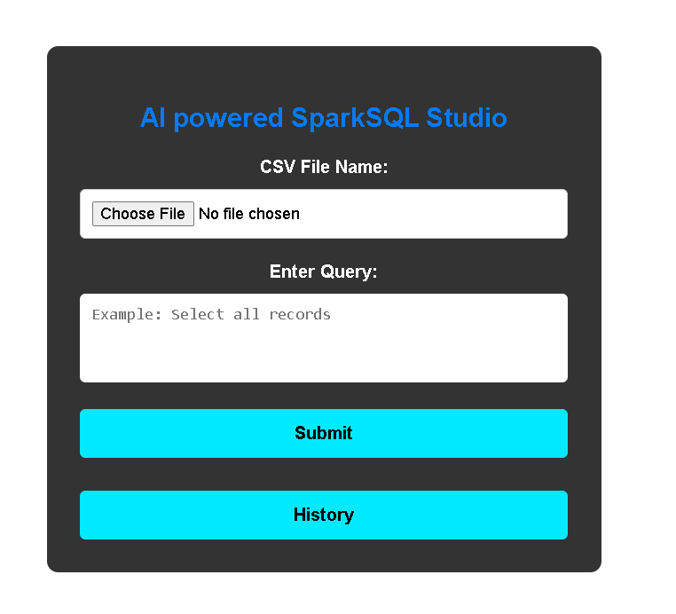
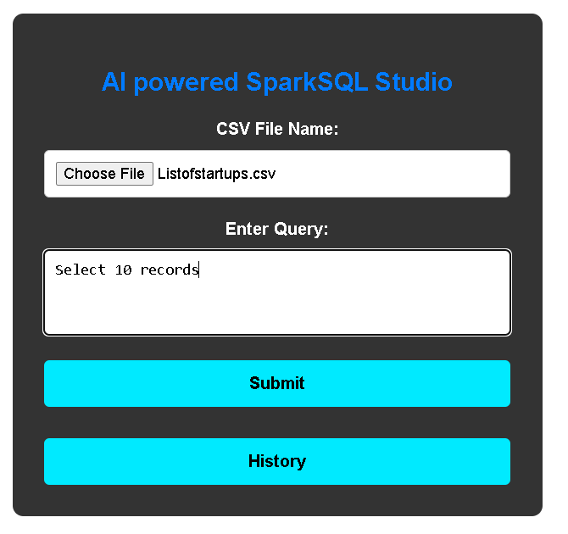
Front Page

Slide 7
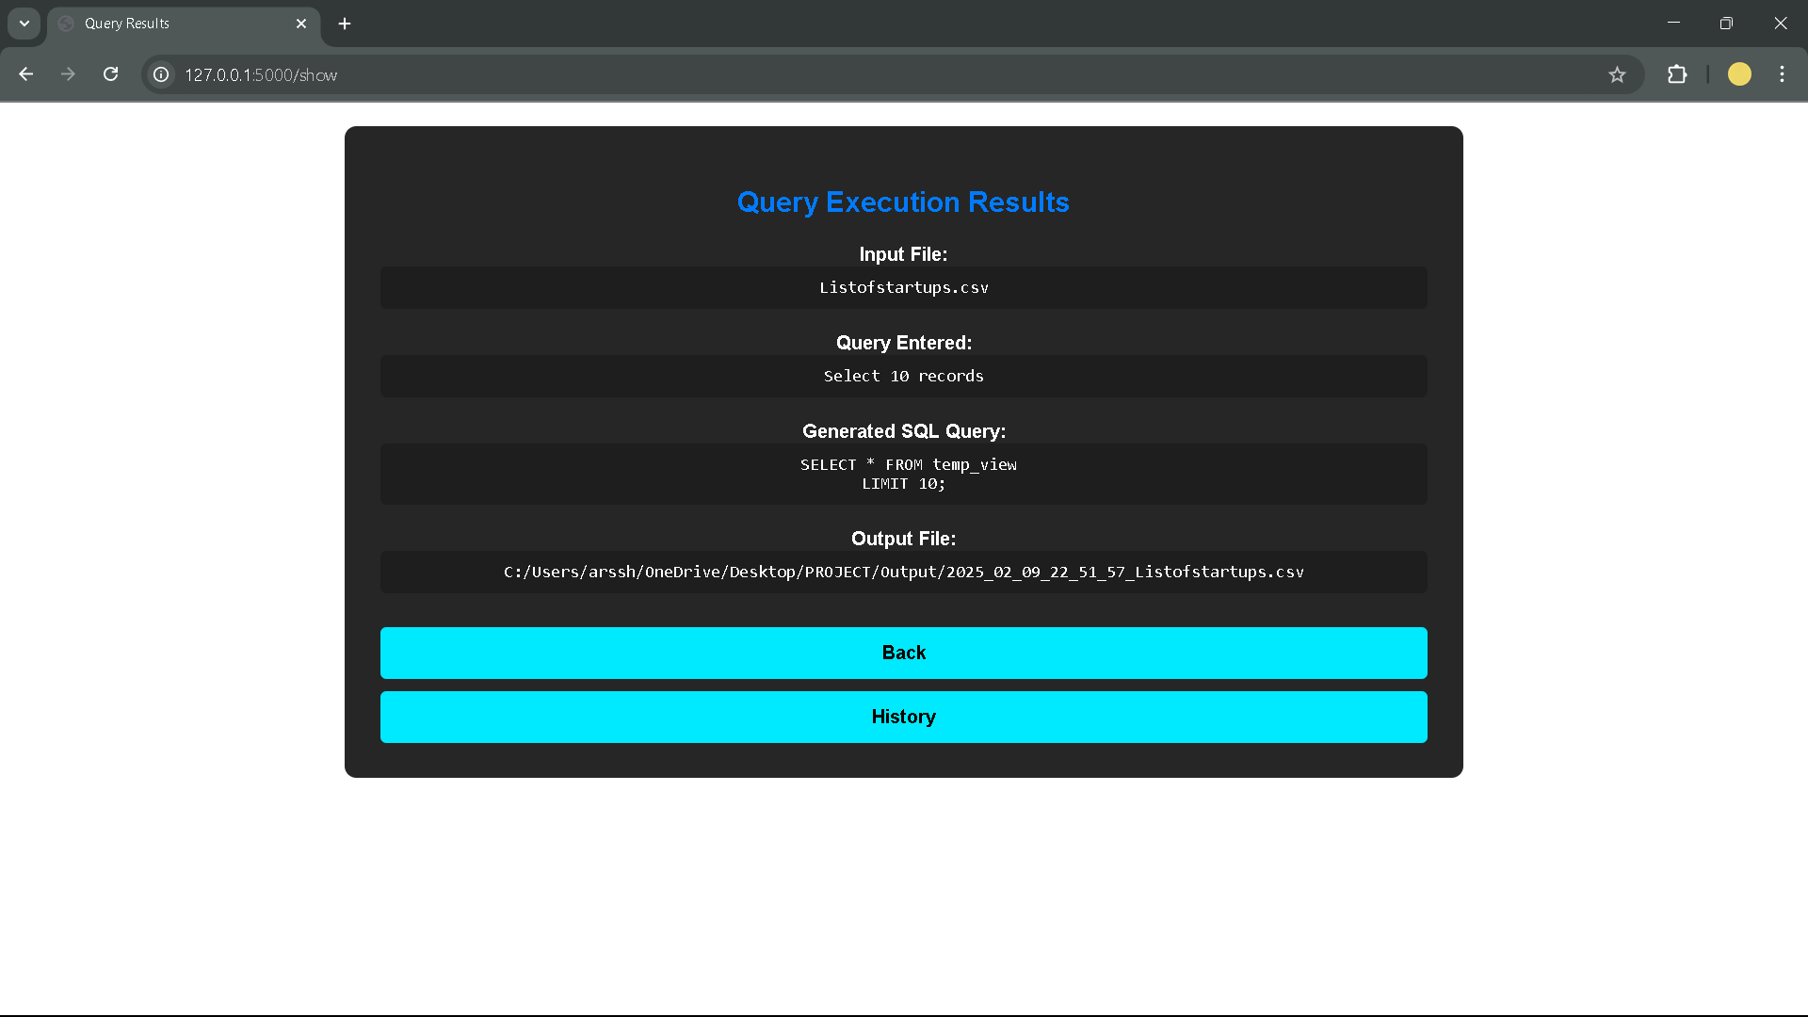
Query Result Page

Slide 8
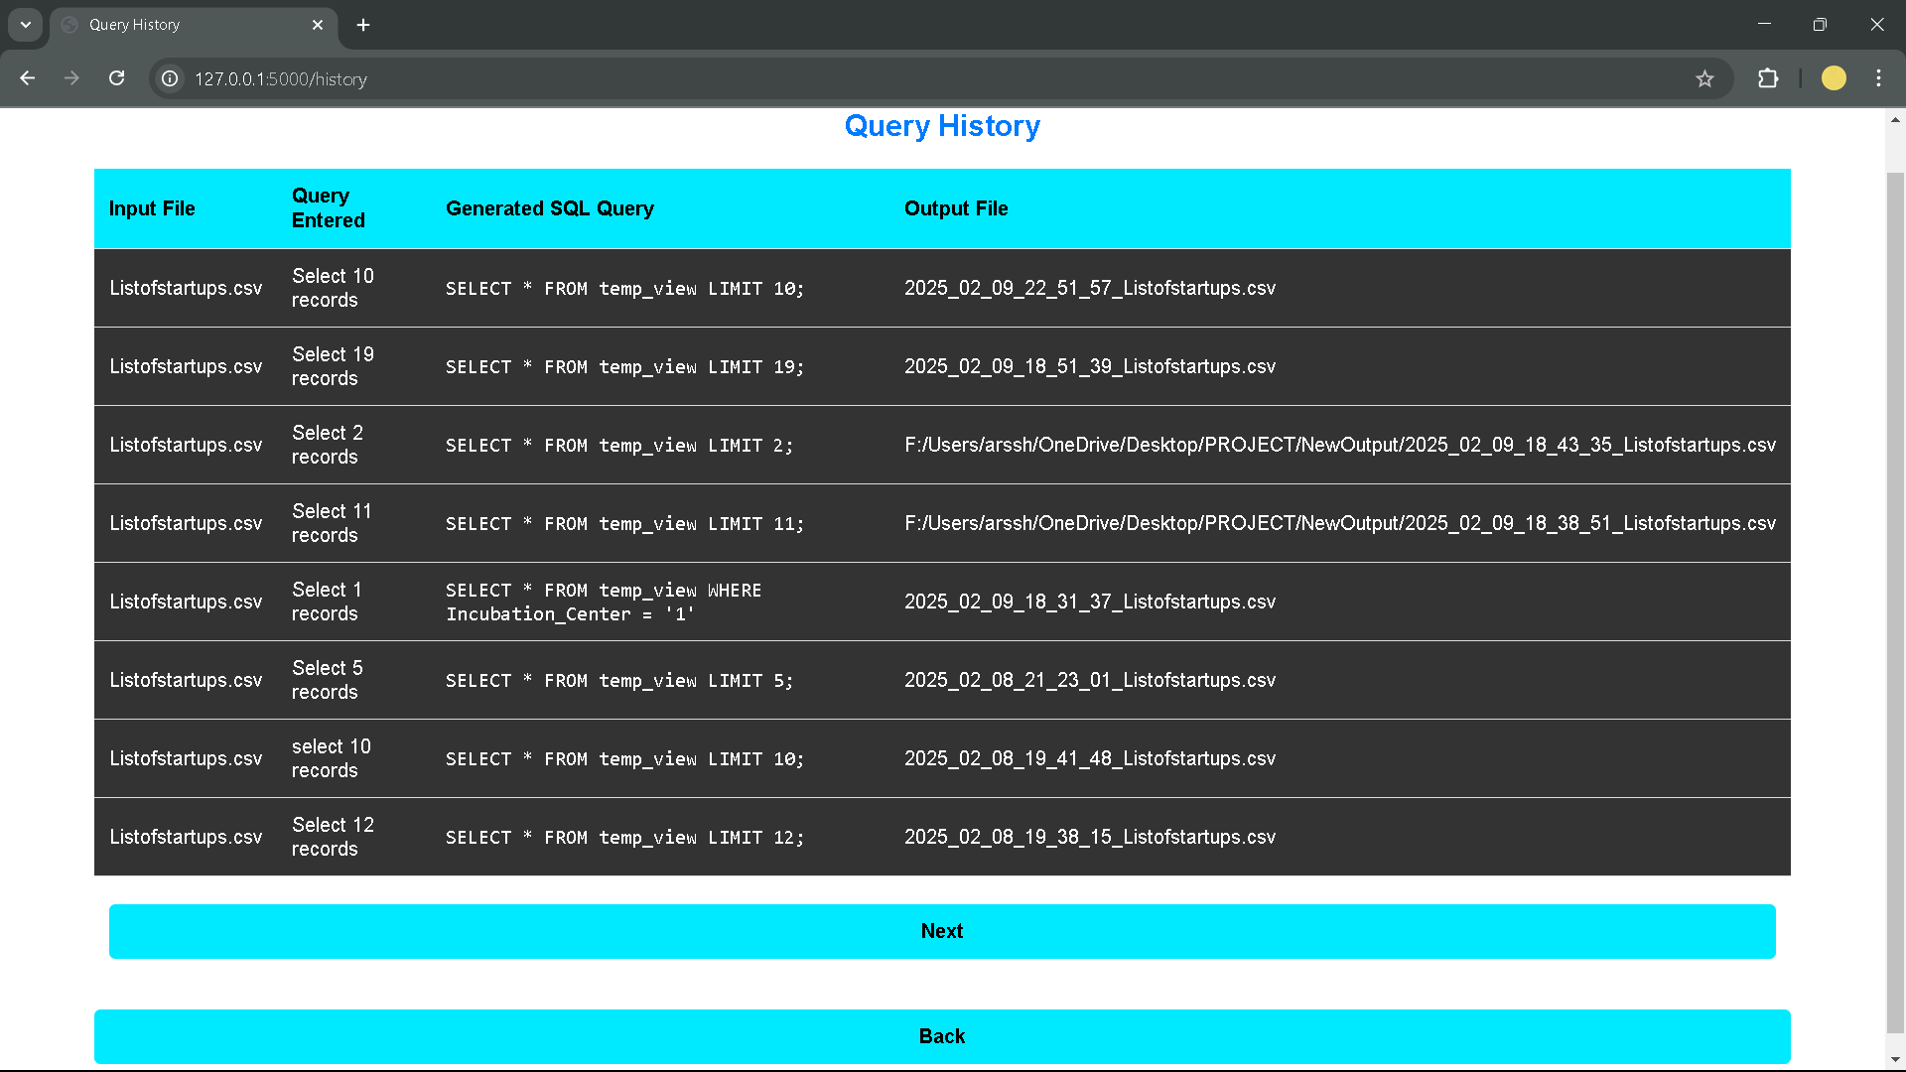
History Page

Slide 9
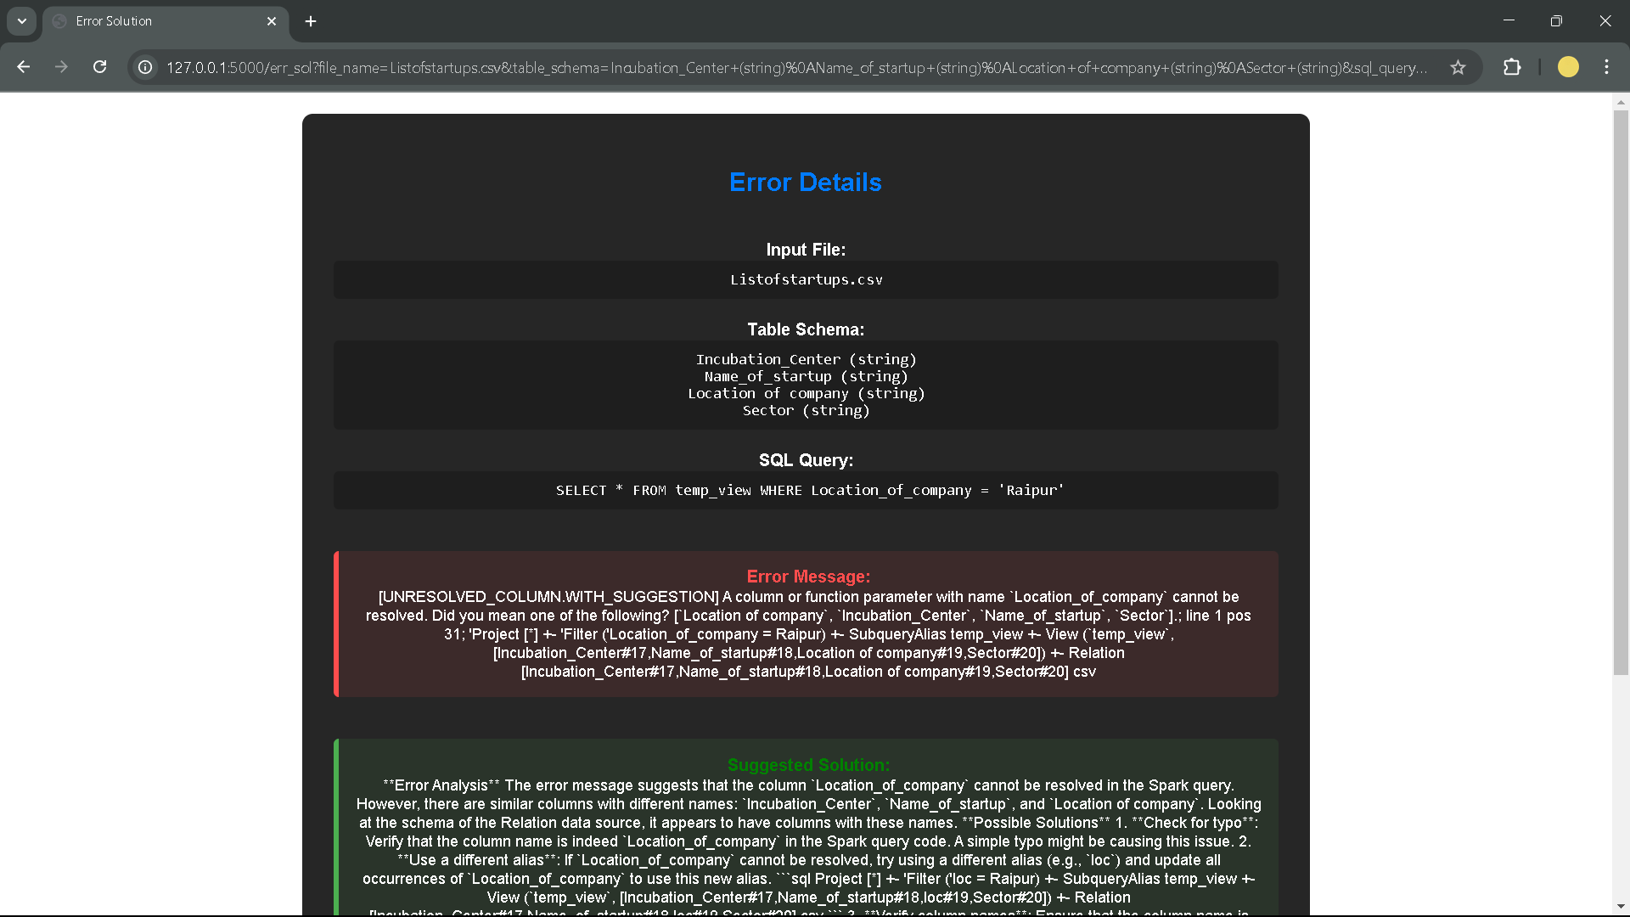
Query Handling Page

Slide 10
Conclusion & Future Scope
Flask effectively bridges user input with Spark processing, ensuring smooth interaction.
It facilitates seamless AI-driven SQL generation and execution.
Future Improvements:
Enhancing LLM accuracy for more precise SQL queries.
Implementing caching mechanisms for frequently used queries to improve efficiency.
Expanding support to multiple databases, including PostgreSQL and MongoDB.

Slide 11
Thank You !!

